Slide 1
Biodiversity and Ecosystem Functioning
Today’s Agenda:
Quiz
BEF: Unanswered Questions

Slide 2
Unanswered Questions in BEF
Your book highlight some important areas where work is still needed:
Effects across multiple trophic levels
Species loss vs introduction
Extinction is global, functions are local
The invasion paradox
The importance of diversity in natural systems
Complicated relationship between diversity and productivity

Slide 3
Unanswered Questions in BEF
Your book highlight some important areas where work is still needed:
Effects across multiple trophic levels
Species loss vs introduction
Extinction is global, functions are local
The invasion paradox
The importance of diversity in natural systems
Complicated relationship between diversity and productivity

Slide 4
Effects across trophic levels
Most BEF experiments only manipulate plant diversity
While many monitor diversity of other groups, they don’t often manipulate it

Slide 5
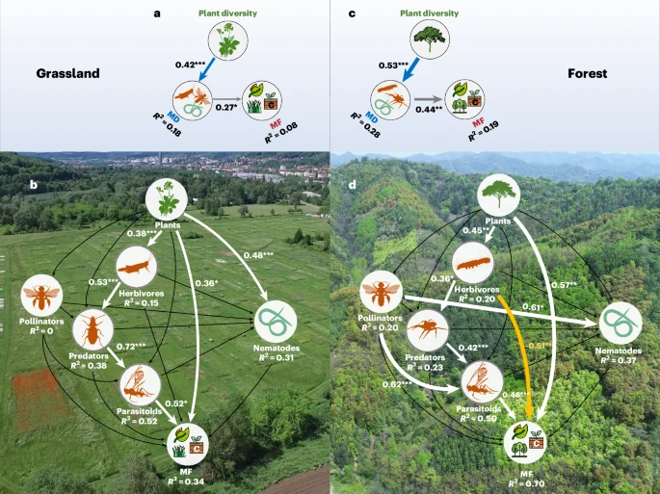
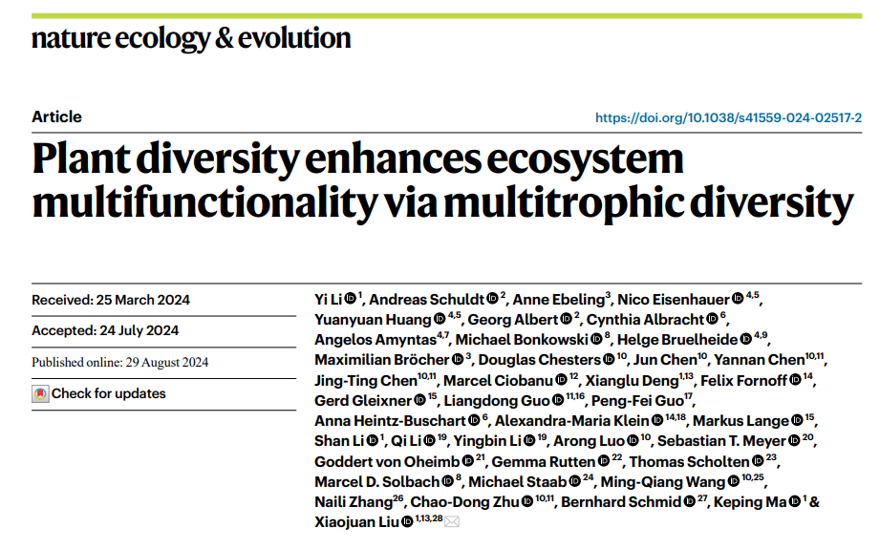
Effects across trophic levels
This paper we discussed yesterday is a step in the right direction!
Notes:
Point out surprising conclusion of weak plant effects on functions, but then again

Slide 6
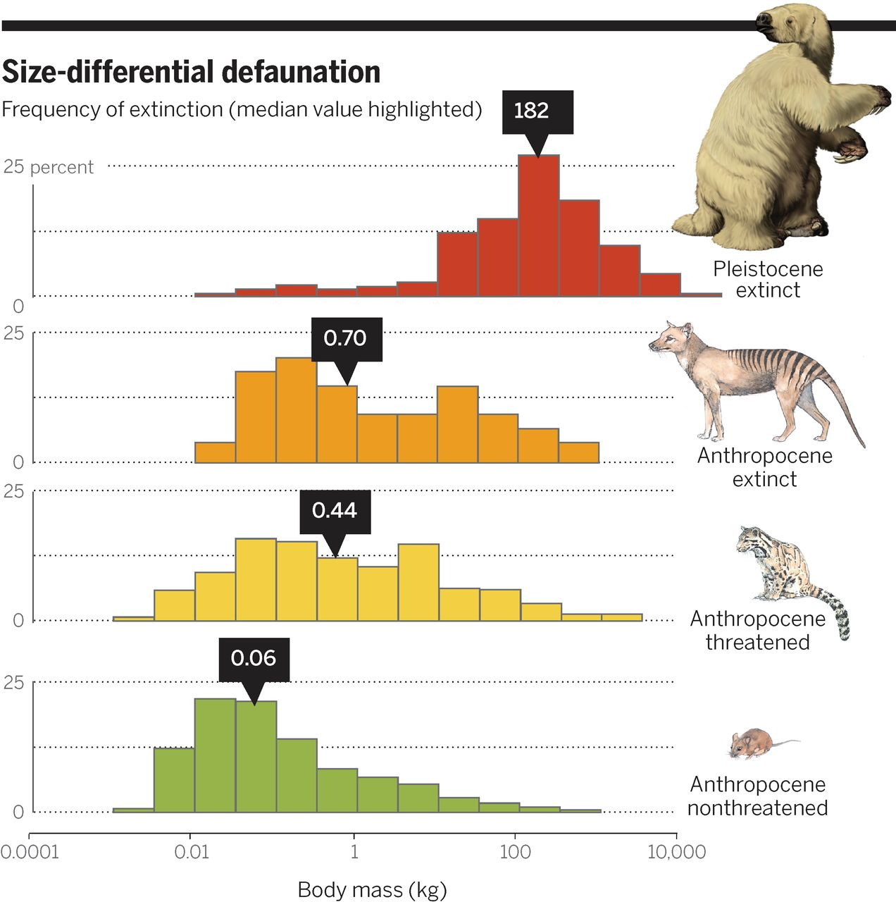
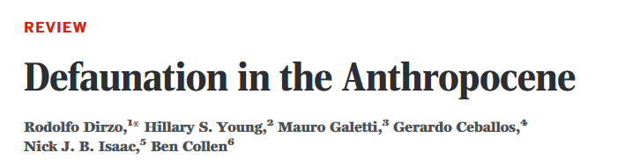
Why is it important?
We’re losing trophic complexity
E.g., top predators, large herbivores
Notes:
Disproportionately losing big things

Slide 7
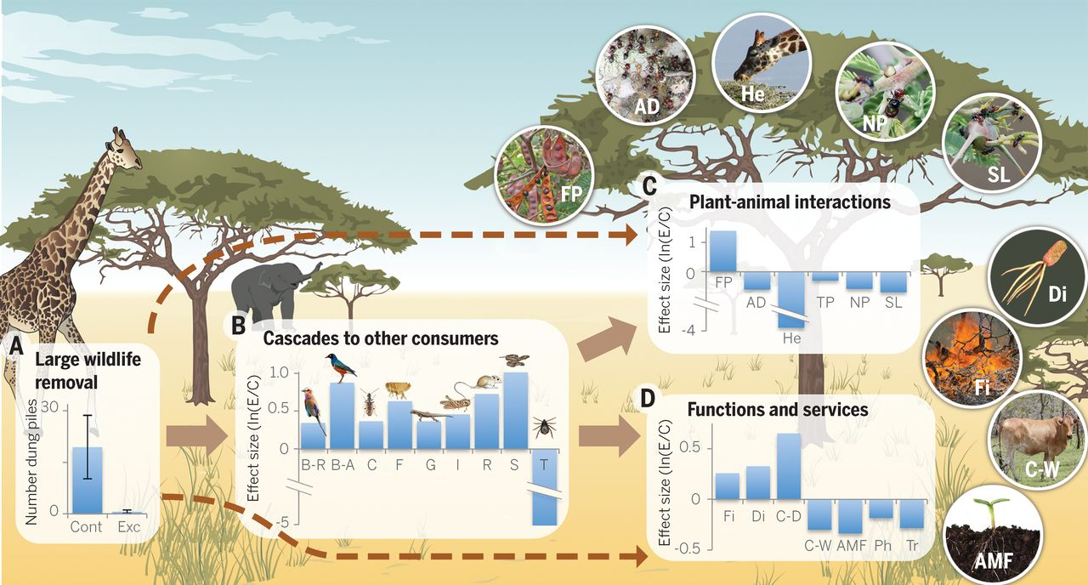
Why is it important?
Removing large wildlife can have large impacts!
Notes:
Large animal removal experiment. Not well replicated, but suggestive! fruit production (FP), ant defense by some species (AD), herbivory of shoots (He), thorn production (TP), nectary production (NP), and spine length (SL); fire intensity (Fi), cattle production in both dry (C-D) and wet (C-W) seasons, disease prevalence (D), infectivity of arbuscular mycorrhizae fungi (AMF), photosynthetic rates (Ph), and transpiration rates (TR)

Slide 8
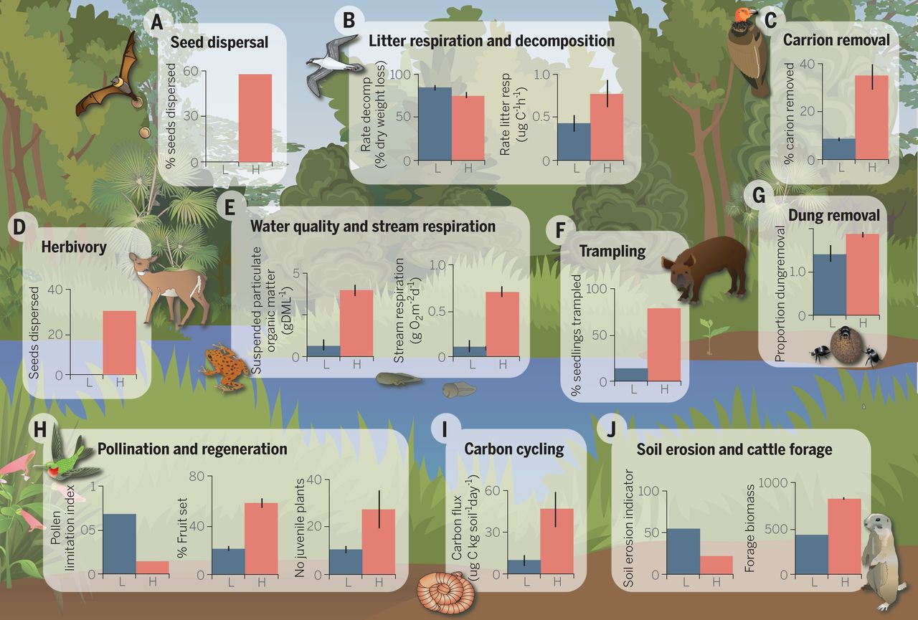
Why is it important?
Removing consumers in general can also have impacts, even the smaller consumers!

Slide 9
Effects across trophic levels
We know the higher trophic levels matter for functioning
Unclear how diversity in higher trophic levels impacts things
Also unclear how diversity interacts across trophic levels
(e.g., do herbivore diversity effects depend on plant diversity?)

Slide 10
Effects across trophic levels
We know the higher trophic levels matter for functioning
Unclear how diversity in higher trophic levels impacts things
Also unclear how diversity interacts across trophic levels
(e.g., do herbivore diversity effects depend on plant diversity?)
Algal or microbial systems in the lab are probably a good place to test!

Slide 11
Unanswered Questions in BEF
Your book highlight some important areas where work is still needed:
Effects across multiple trophic levels
Species loss vs introduction
Extinction is global, functions are local
The invasion paradox
The importance of diversity in natural systems
Complicated relationship between diversity and productivity

Slide 12
Unanswered Questions in BEF
Your book highlight some important areas where work is still needed:
Effects across multiple trophic levels
Species loss vs introduction
Extinction is global, functions are local
The invasion paradox
The importance of diversity in natural systems
Complicated relationship between diversity and productivity

Slide 13
Species loss vs introduction
Most BEF experiments focus on assembling species
Individuals of selected species are added to an unoccupied environment

Slide 14
Species loss vs introduction
Most BEF experiments focus on assembling species
Individuals of selected species are added to an unoccupied environment
Adding species to an empty area == removing species from an occupied area?

Slide 15
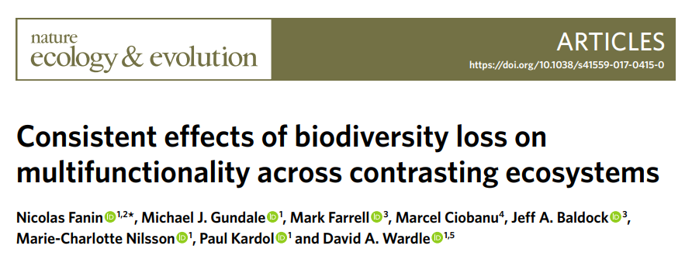
Testing BEF with removal
Island experiment in Sweden
30 islands, 14 plots each (n = 420 total)
Removed 0 to 3 functional groups (tree, shrub, moss)
Removed 0 to 3 species of shrub
Measured 15 ecosystem functions

Slide 16
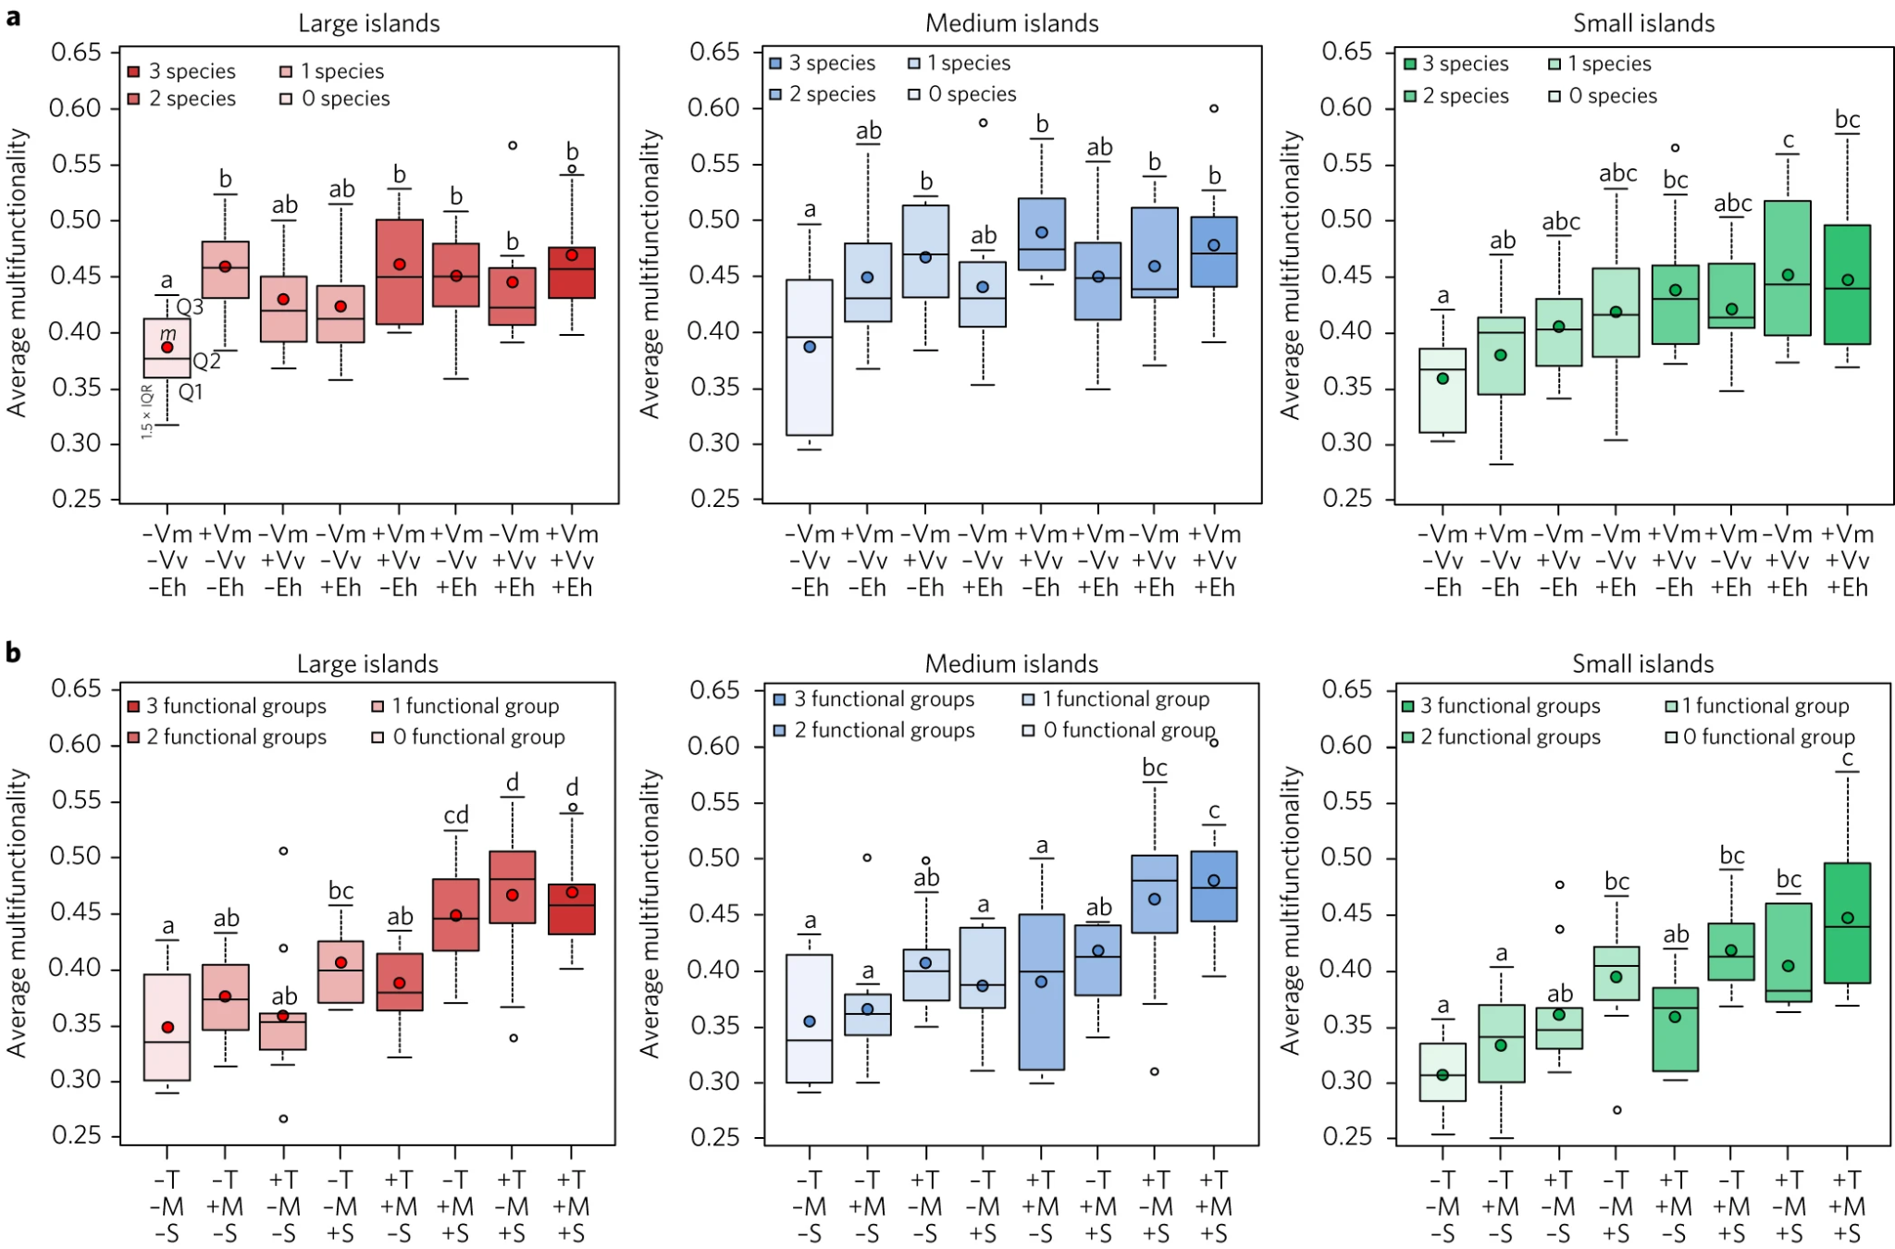
Testing BEF with removal
Notes:
(V. myrtillus (–Vm), V. vitis-idaea (–Vv) or E. hermaphroditum (–Eh); (trees (–T), shrubs (–S) and mosses (–M)

Slide 17
BEF and removal
Need for experiments that use both addition and removal
Relatively fast systems probably most amenable (e.g. algae)
Some experiments suggest that order of arrival matters

Slide 18
Unanswered Questions in BEF
Your book highlight some important areas where work is still needed:
Effects across multiple trophic levels
Species loss vs introduction
Extinction is global, functions are local
The invasion paradox
The importance of diversity in natural systems
Complicated relationship between diversity and productivity

Slide 19
Unanswered Questions in BEF
Your book highlight some important areas where work is still needed:
Effects across multiple trophic levels
Species loss vs introduction
Extinction is global, functions are local
The invasion paradox
The importance of diversity in natural systems
Complicated relationship between diversity and productivity

Slide 20
Extinction is global, functions are local
Strong evidence that humans are causing lots of extinctions

Slide 21
Extinction is global, functions are local
Strong evidence that humans are causing lots of extinctions

Slide 22
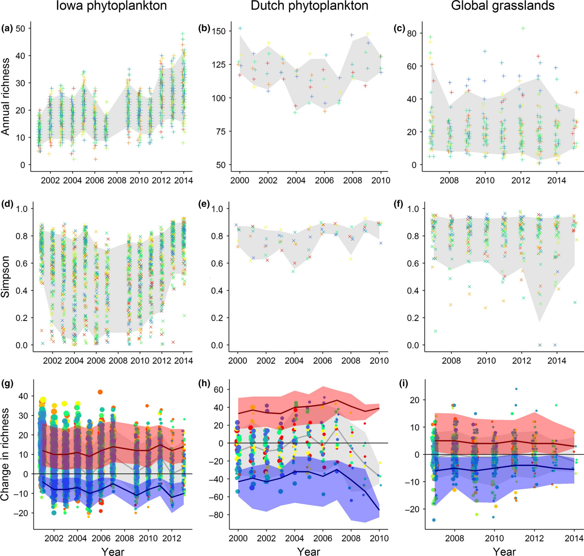
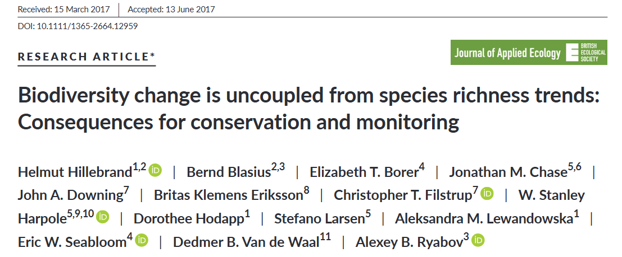
Net local change
But species introductions can balance out local extirpations

Slide 23
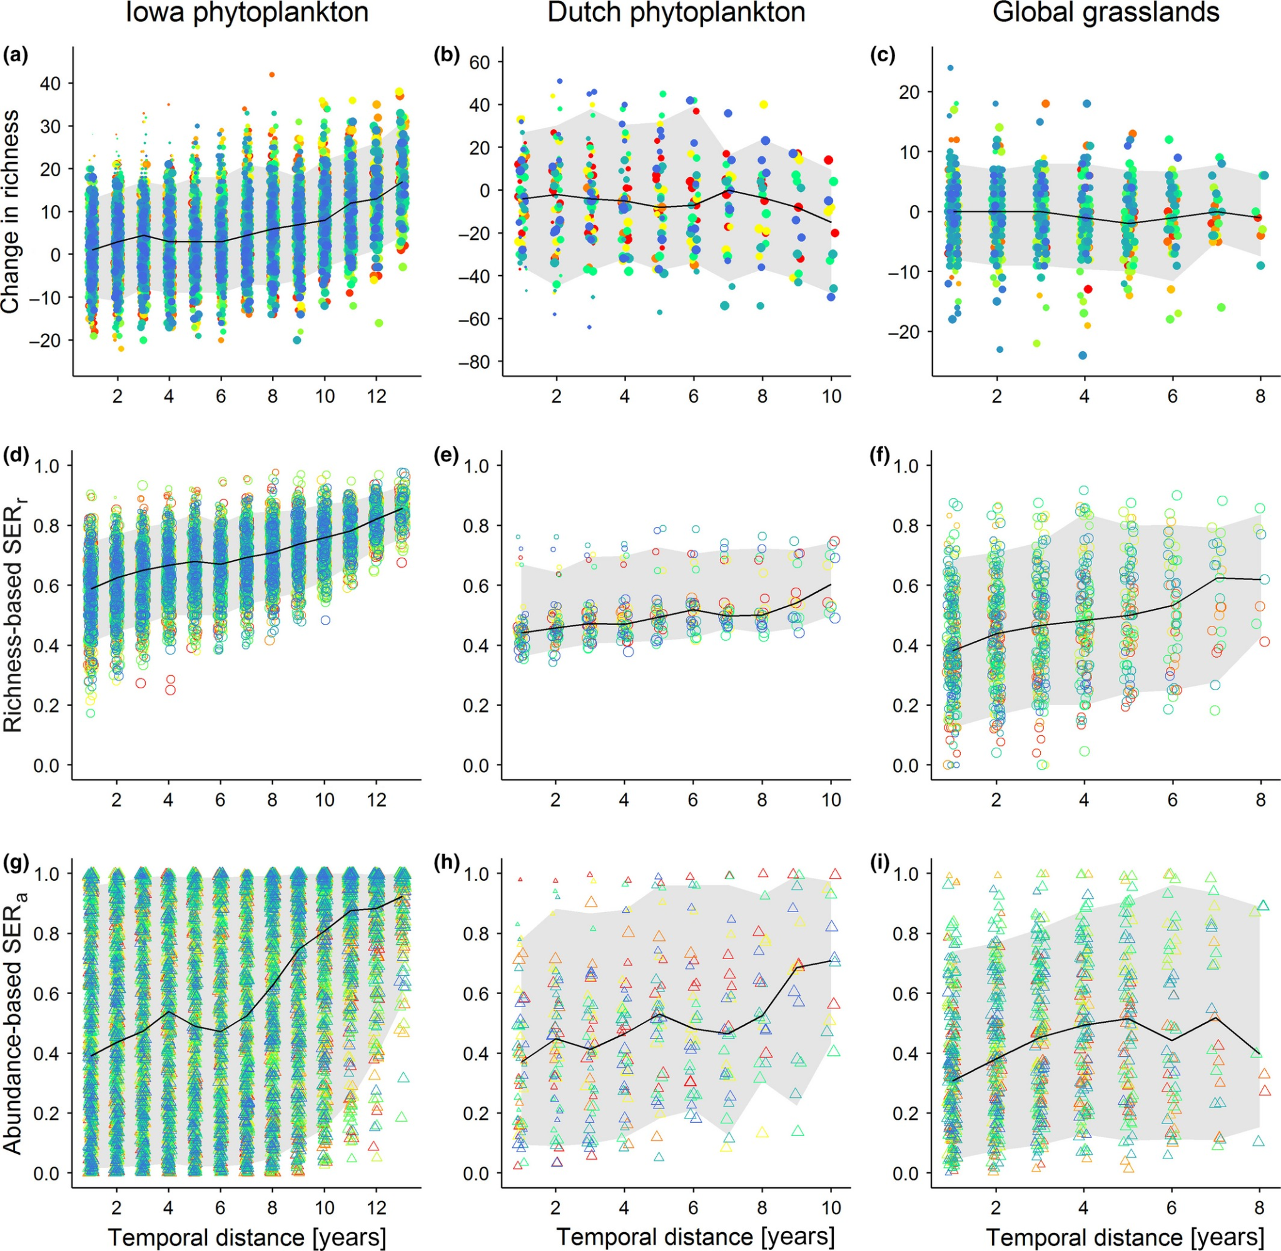
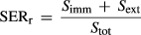
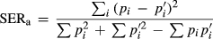
Net local change
But species introductions can balance out local extirpations
Notes:
Imm = immigration, ext = extinction, tot = total; species proportional abundances, pi and pi’, in the first (time 1) and second (time 2) community, respectively;

Slide 24
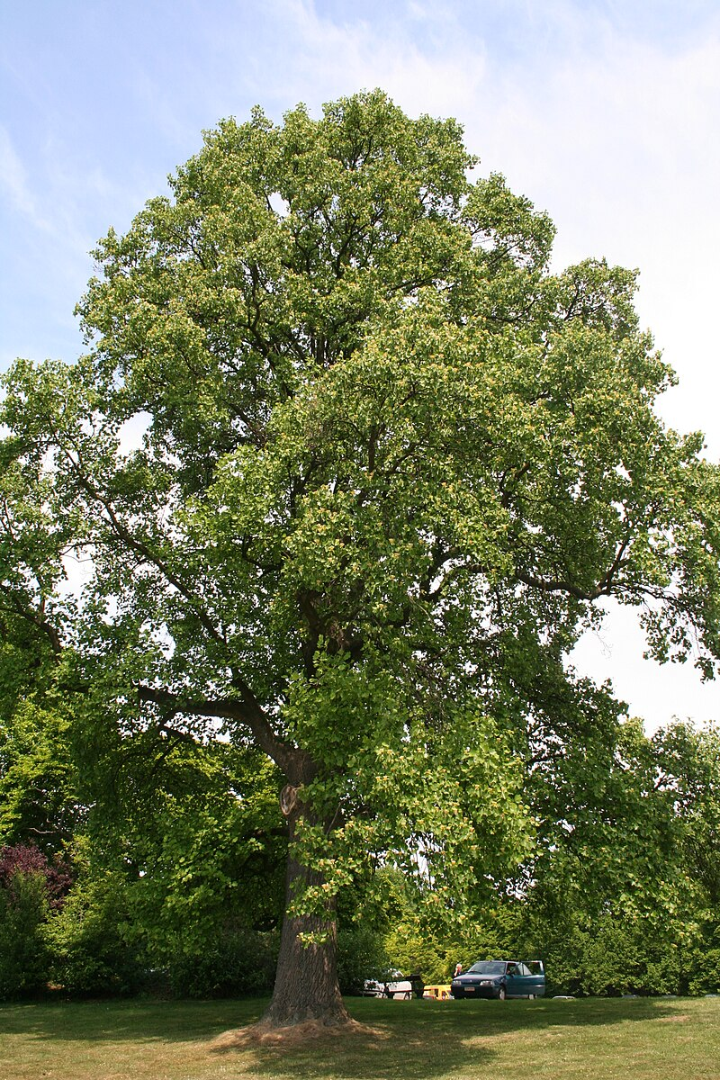
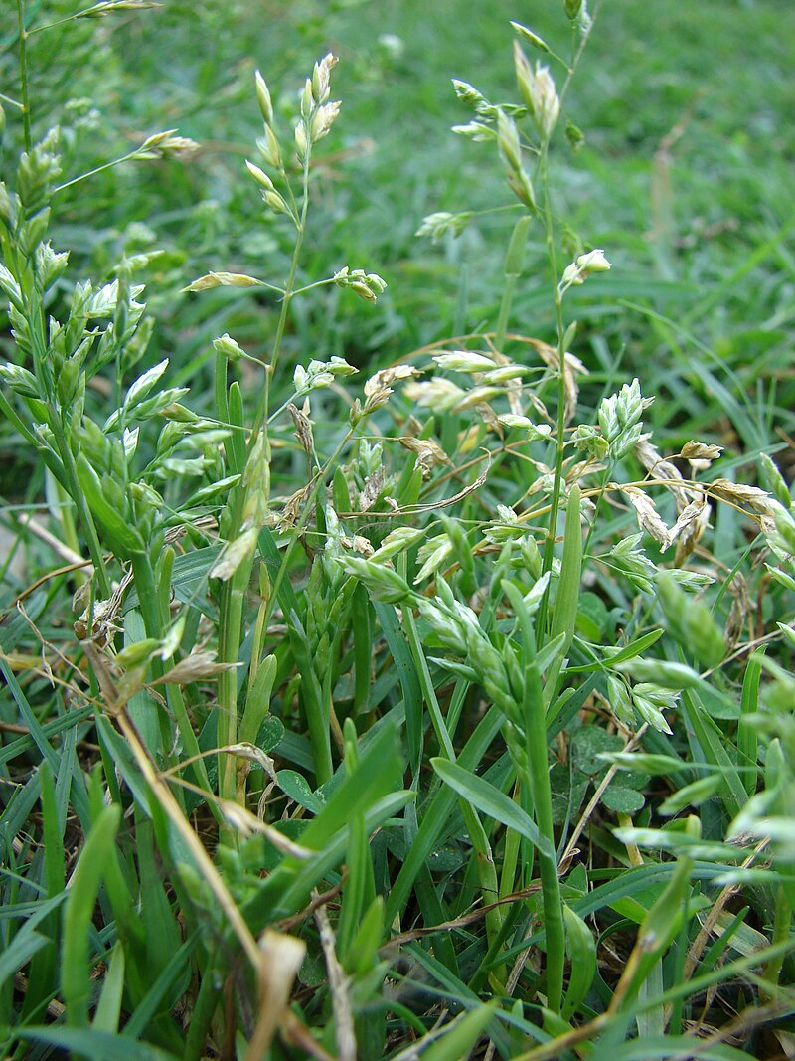

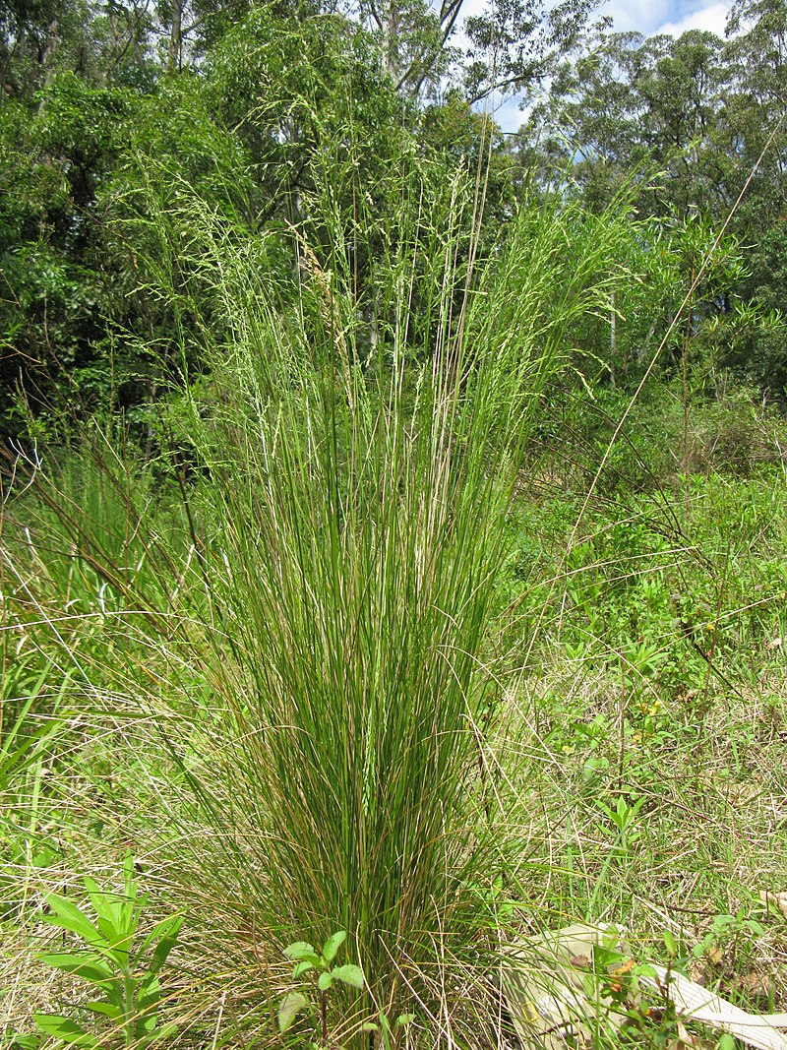
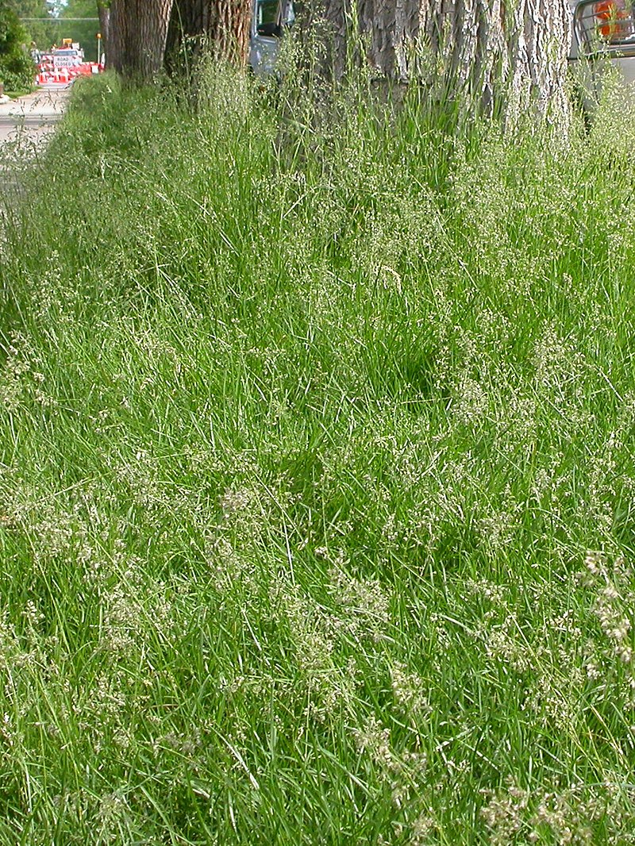
Need to go beyond species richness
Species richness only gets us so far
Richness can stay constant despite major changes in species
Moving to a trait-based approach may help
vs
Images: By Macleay Grass Man - https://www.flickr.com/photos/73840284@N04/8365558811/, CC BY 2.0, https://commons.wikimedia.org/w/index.php?curid=26731288;Forest & Kim Starr; By Matt Lavin from Bozeman, Montana, USA - Poa pratensis Uploaded by Jacopo Werther, CC BY-SA 2.0, https://commons.wikimedia.org/w/index.php?curid=126336372 ; By Jean-Pol GRANDMONT - Own work, CC BY 3.0, https://commons.wikimedia.org/w/index.php?curid=9873223; Suki Lee

Slide 25
Unanswered Questions in BEF
Your book highlight some important areas where work is still needed:
Effects across multiple trophic levels
Species loss vs introduction
Extinction is global, functions are local
The invasion paradox
The importance of diversity in natural systems
Complicated relationship between diversity and productivity

Slide 26
Unanswered Questions in BEF
Your book highlight some important areas where work is still needed:
Effects across multiple trophic levels
Species loss vs introduction
Extinction is global, functions are local
The invasion paradox
The importance of diversity in natural systems
Complicated relationship between diversity and productivity

Slide 27
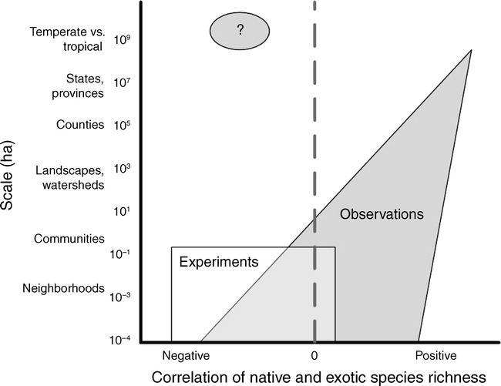
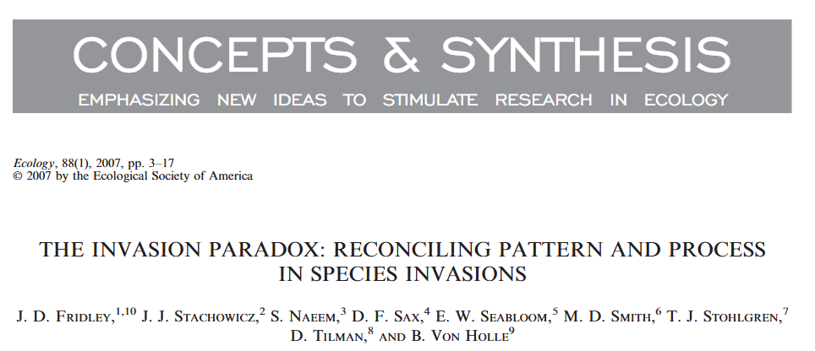
The Invasion Paradox

Slide 28
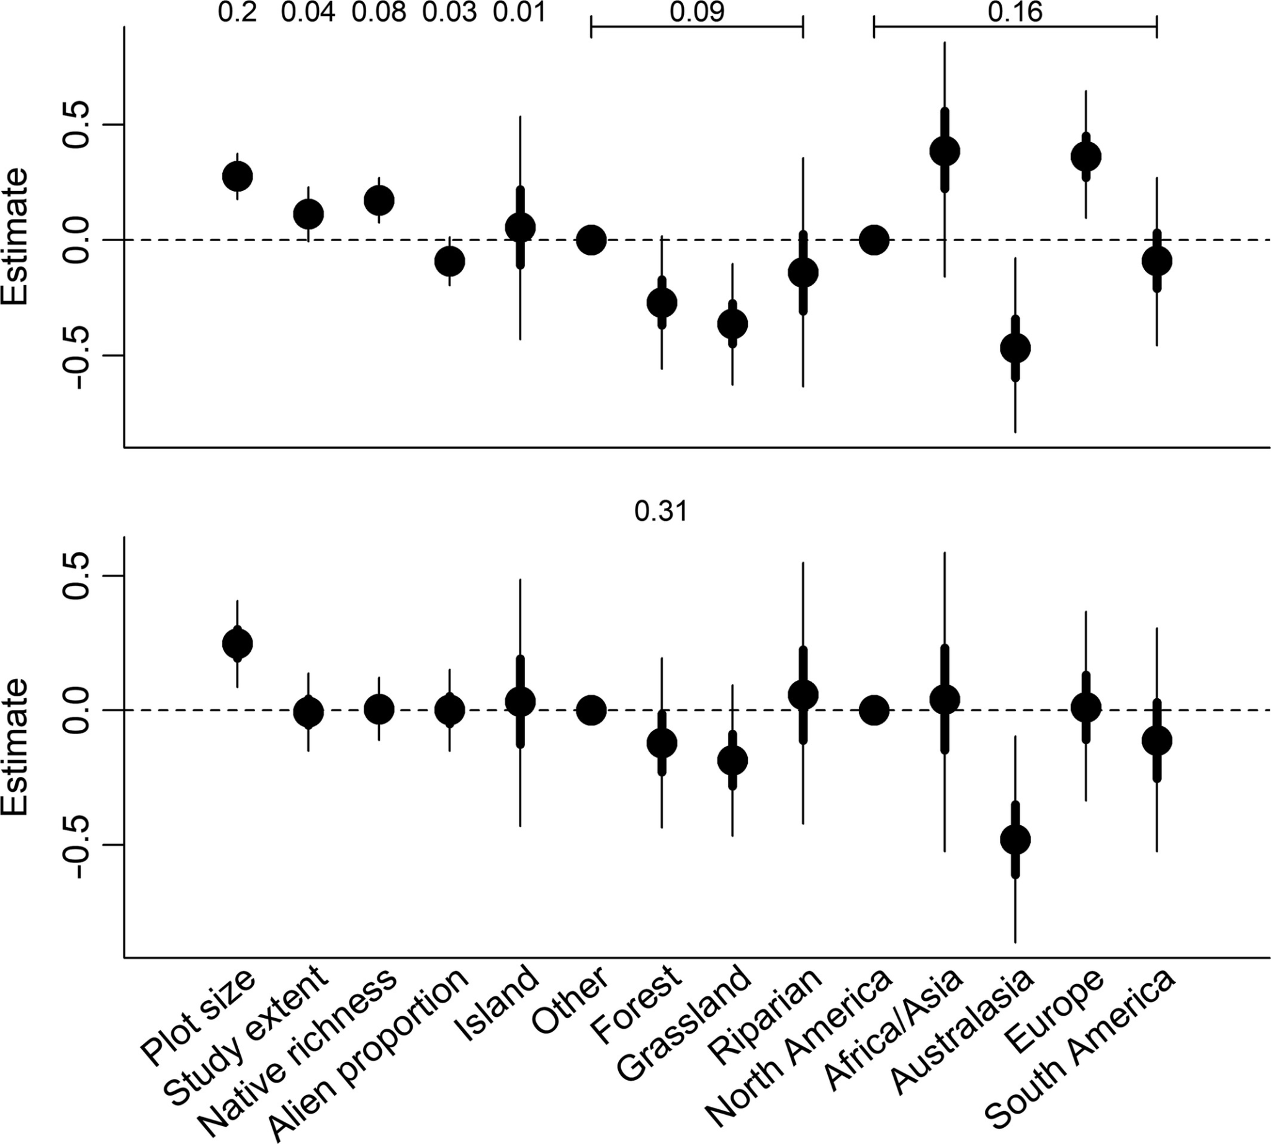
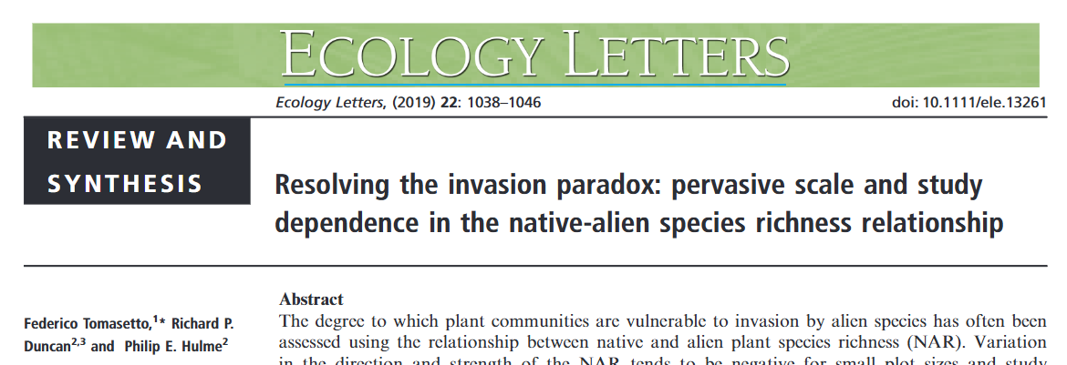
The Invasion Paradox

Slide 29
The Invasion Paradox

Slide 30
The Invasion Paradox
Why?
Same factors that drive native species richness drive introduced species richness?
Experiments often relatively homogeneous, as opposed to more natural systems
More work needs to be done

Slide 31
Unanswered Questions in BEF
Your book highlight some important areas where work is still needed:
Effects across multiple trophic levels
Species loss vs introduction
Extinction is global, functions are local
The invasion paradox
The importance of diversity in natural systems
Complicated relationship between diversity and productivity

Slide 32
Unanswered Questions in BEF
Your book highlight some important areas where work is still needed:
Effects across multiple trophic levels
Species loss vs introduction
Extinction is global, functions are local
The invasion paradox
The importance of diversity in natural systems
Complicated relationship between diversity and productivity

Slide 33
BEF in natural systems
Much of what we know is from experimental systems
How important are these effects in natural systems?

Slide 34
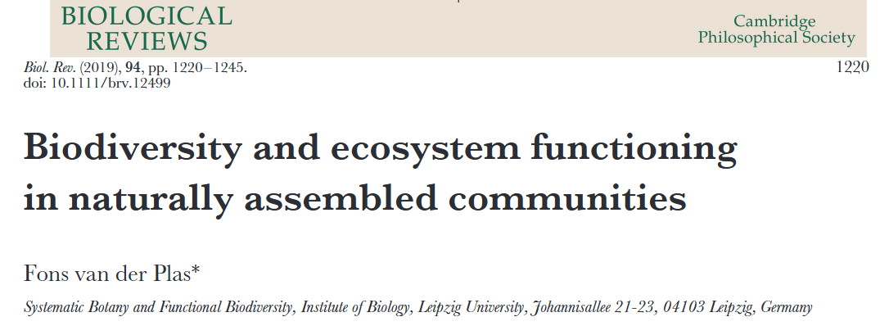
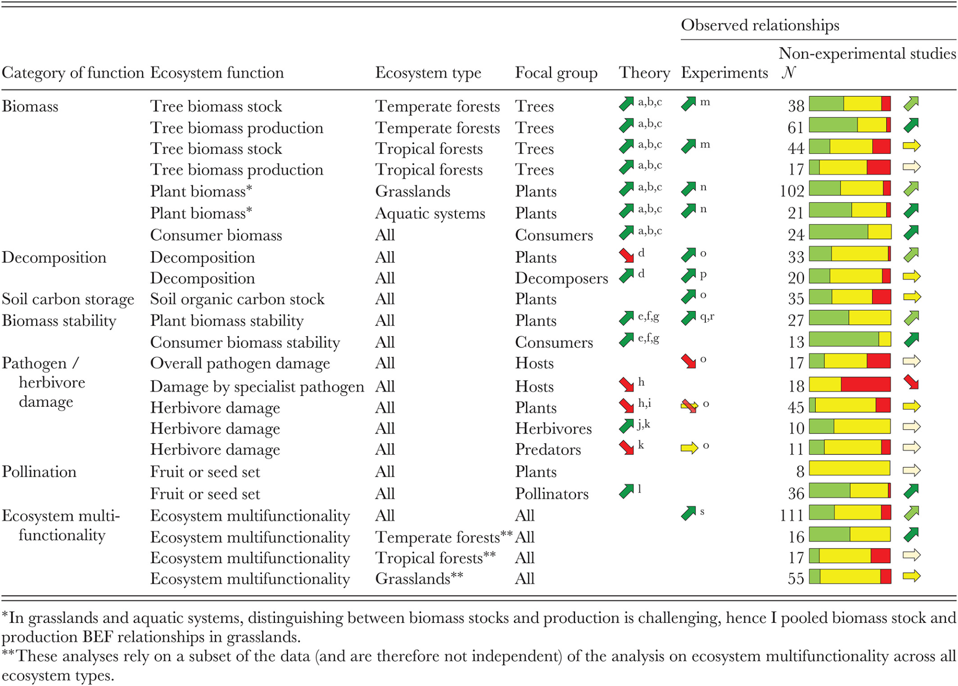
BEF in natural systems

Slide 35
BEF in natural systems

Slide 36
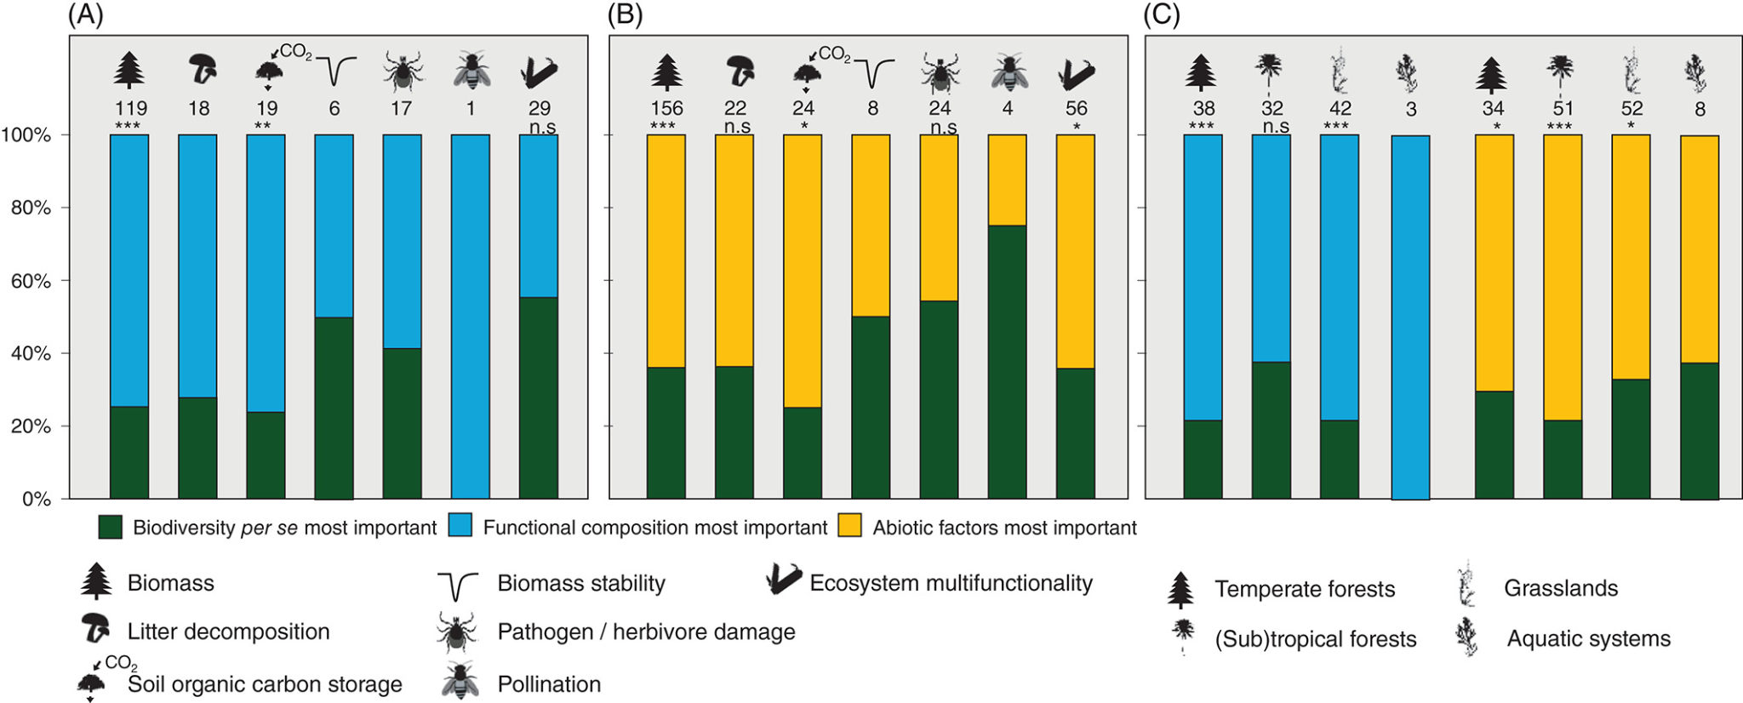
BEF in natural systems

Slide 37
BEF in natural vs experimental systems
Some relationships seems consistent, others differ
Richness isn’t usually the main factor - functional composition matters more

Slide 38
Unanswered Questions in BEF
Your book highlight some important areas where work is still needed:
Effects across multiple trophic levels
Species loss vs introduction
Extinction is global, functions are local
The invasion paradox
The importance of diversity in natural systems
Complicated relationship between diversity and productivity

Slide 39
Unanswered Questions in BEF
Your book highlight some important areas where work is still needed:
Effects across multiple trophic levels
Species loss vs introduction
Extinction is global, functions are local
The invasion paradox
The importance of diversity in natural systems
Complicated relationship between diversity and productivity

Slide 40
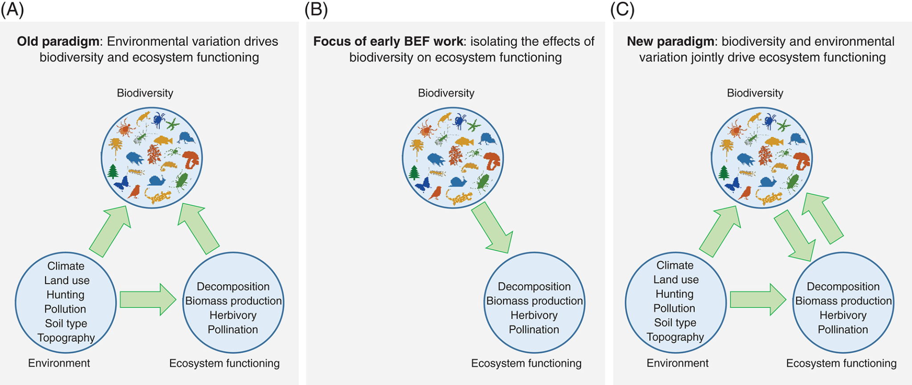
BEF: It’s complicated

Slide 41
BEF: It’s complicated

Slide 42
BEF: It’s complicated

Slide 43
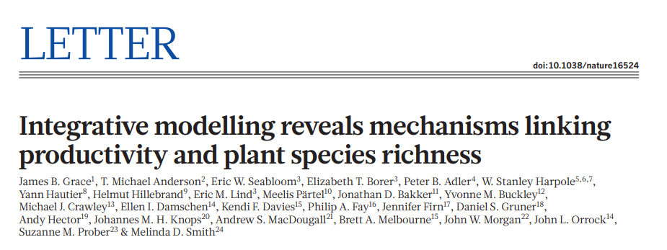
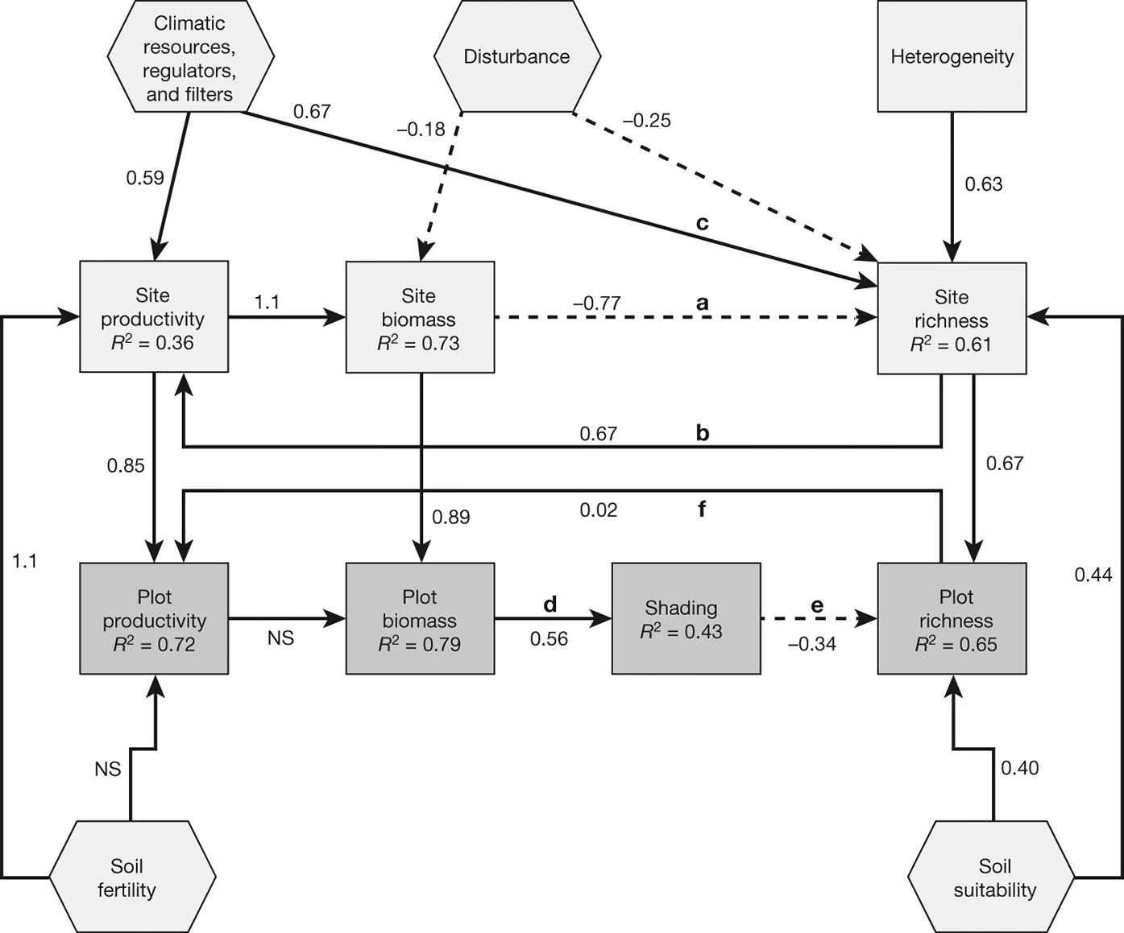
BEF: It’s complicated
Notes:
Solid lines = positive, dashed lines = negative

Slide 44
BEF: It’s complicated
Complicated relationships might also explain differences between experiments and nature!
Or variation among systems!
Notes:
Solid lines = positive, dashed lines = negative

Slide 45
Unanswered Questions in BEF
Your book highlight some important areas where work is still needed:
Effects across multiple trophic levels
Species loss vs introduction
Extinction is global, functions are local
The invasion paradox
The importance of diversity in natural systems
Complicated relationship between diversity and productivity

Slide 46
Unanswered Questions in BEF
Your book highlight some important areas where work is still needed:
Effects across multiple trophic levels
Species loss vs introduction
Extinction is global, functions are local
The invasion paradox
The importance of diversity in natural systems
Complicated relationship between diversity and productivity

Slide 47
Next class: Density Dependence!

